Slide 1

Cafe Management System
by:
S.Mekala
2020IT17

Slide 2
Abstract:
In this project the CAFE MANAGEMENT SYSTEM ,the objective of this application is to generate the bill , print the bill and view the bill . It make the users work simple , efficient and save our time.
The user first signup for set up an account and they should give the details of their name , Email , mobile number , address , password , security question , answer.
Then enter to login page they should give the details of their Email and password then only they go to home page.

Slide 3
FRONT END & BACK END
Front End : Vb . Net
Back End : Oracle Database

Slide 4
Existing System:
Most of the Cafe shop have a signup page and two login one is user login and another one is admin login.
The user login will have a place order , view bill and order place , change password, change security question.
This admin login will have additional functionalities when compared to the common user , he have a manage category , add new product , view edit &delete product ,verify users.

Slide 5
Propose System:
Most of the cafe shops don’t have the graph view of their sales income and compare two month or year sales.
It is also used to identify which sales person or sales branch has in high sales range.
It help to easily identify the sales profit and lose.

Slide 6
Modules:
The entire system is divided into six major modules
Signup & login.
User functions.
Change password & security question.
Manage Category.
Verify Users.
Manipulate product.

Slide 7
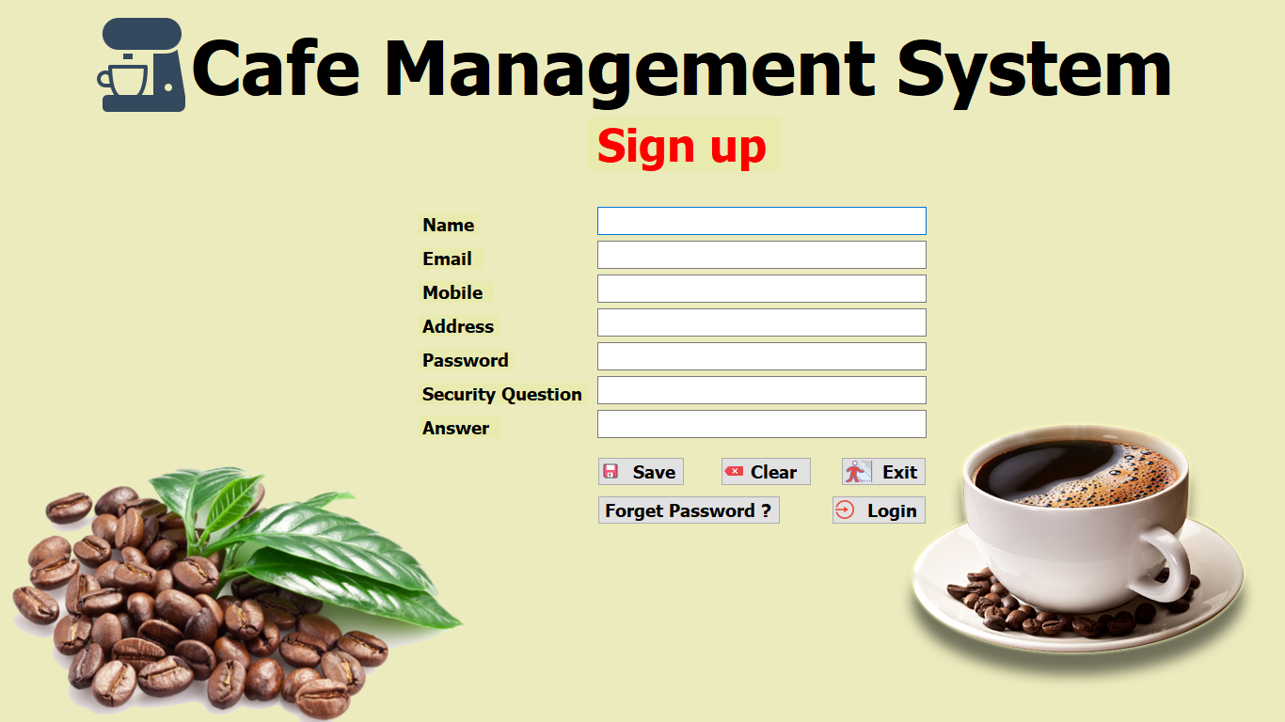
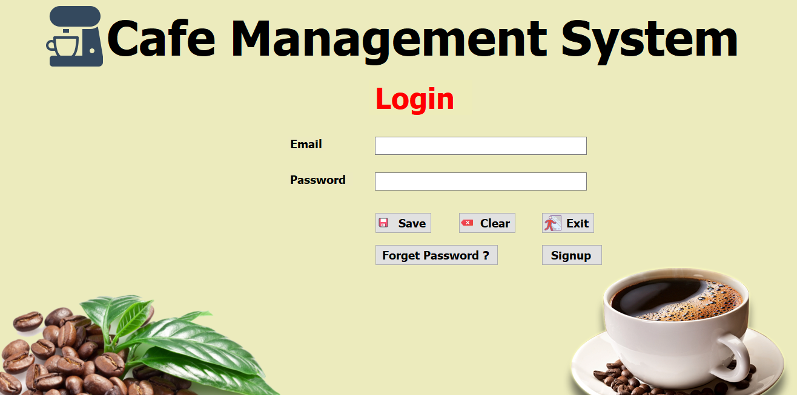
Signup & Login

Slide 8
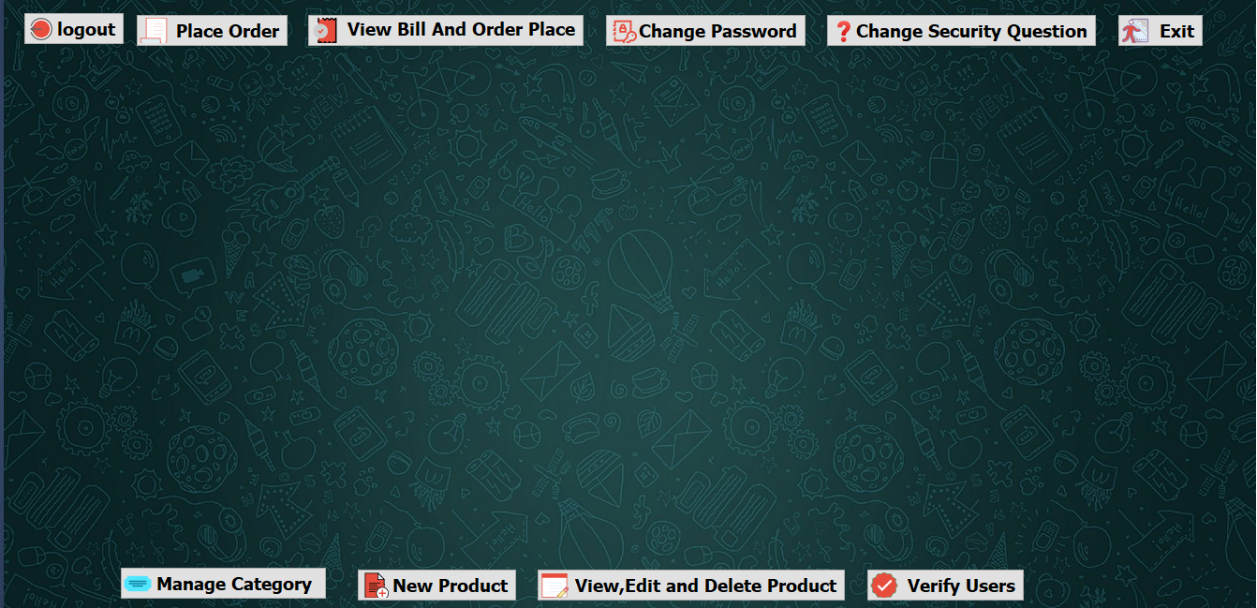
Home Page

Slide 9
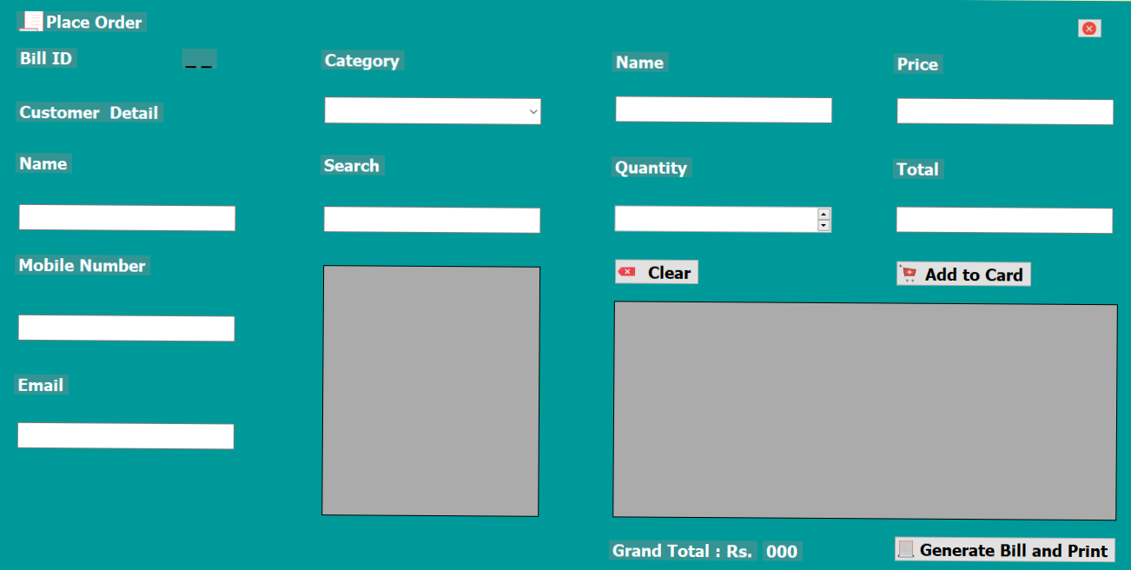
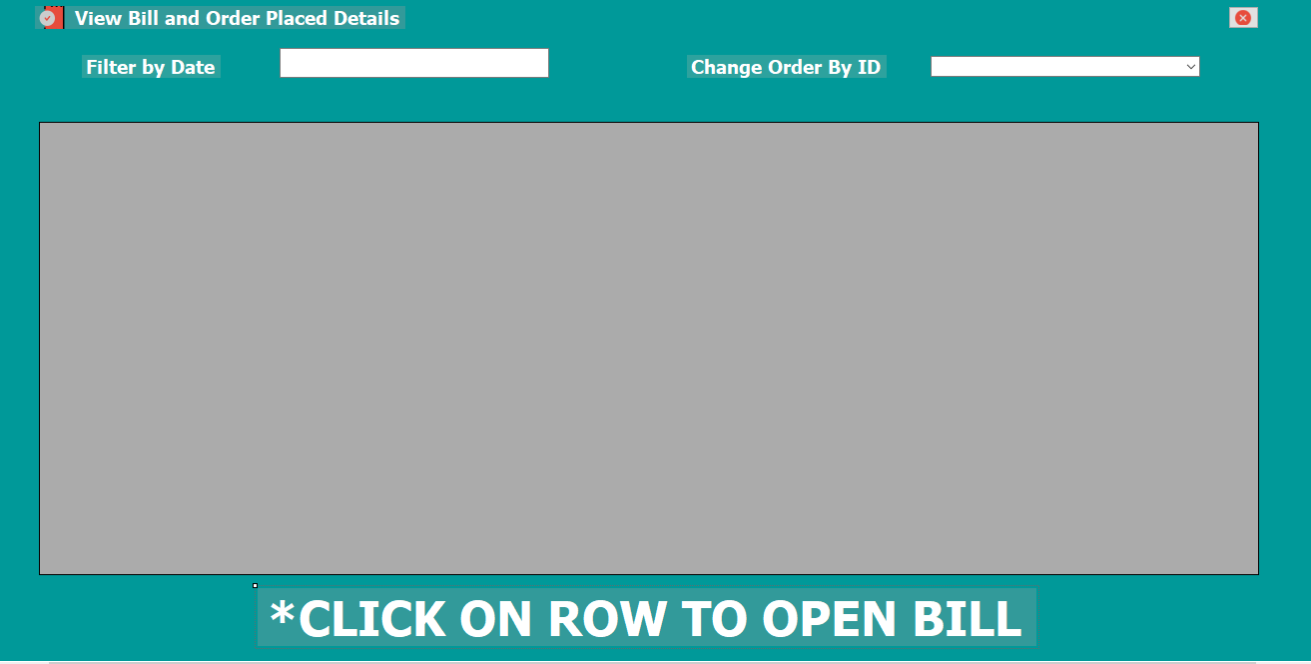
User Functions
View Bill &Order Place Details
Place Order

Slide 10
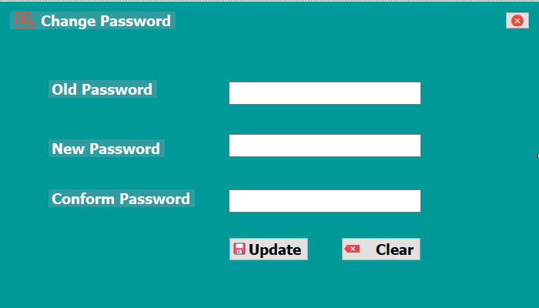
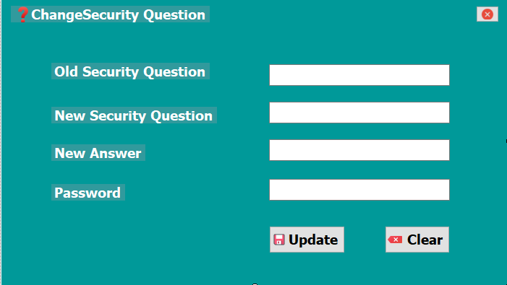
Change Password &Security
Question

Slide 11
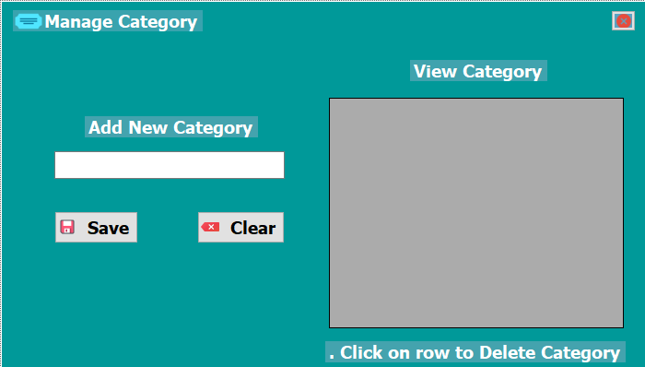
Manage Category

Slide 12
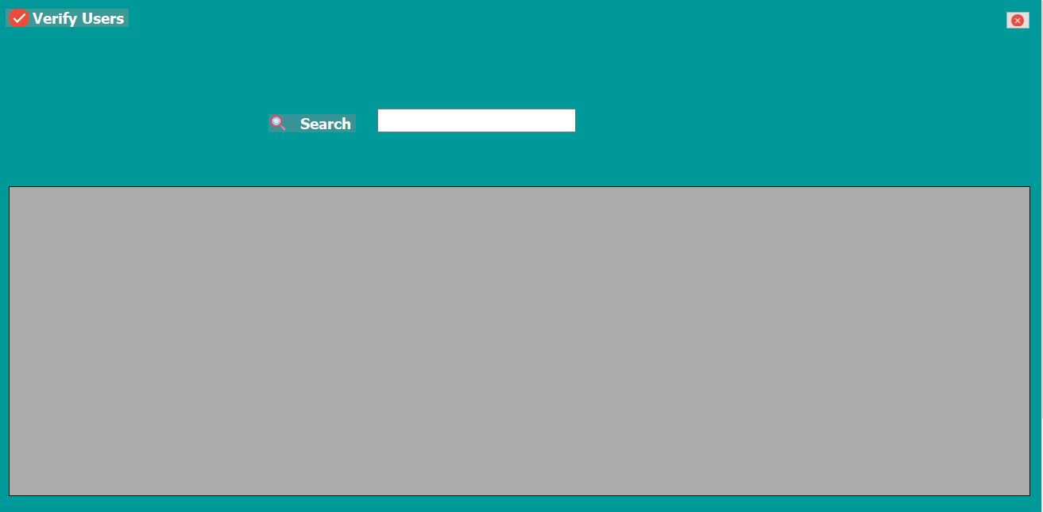
Verify Users

Slide 13
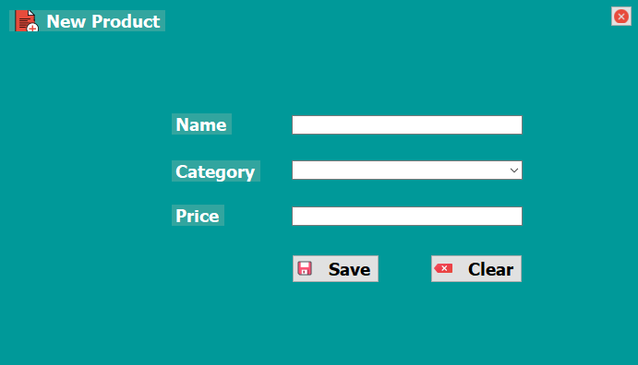
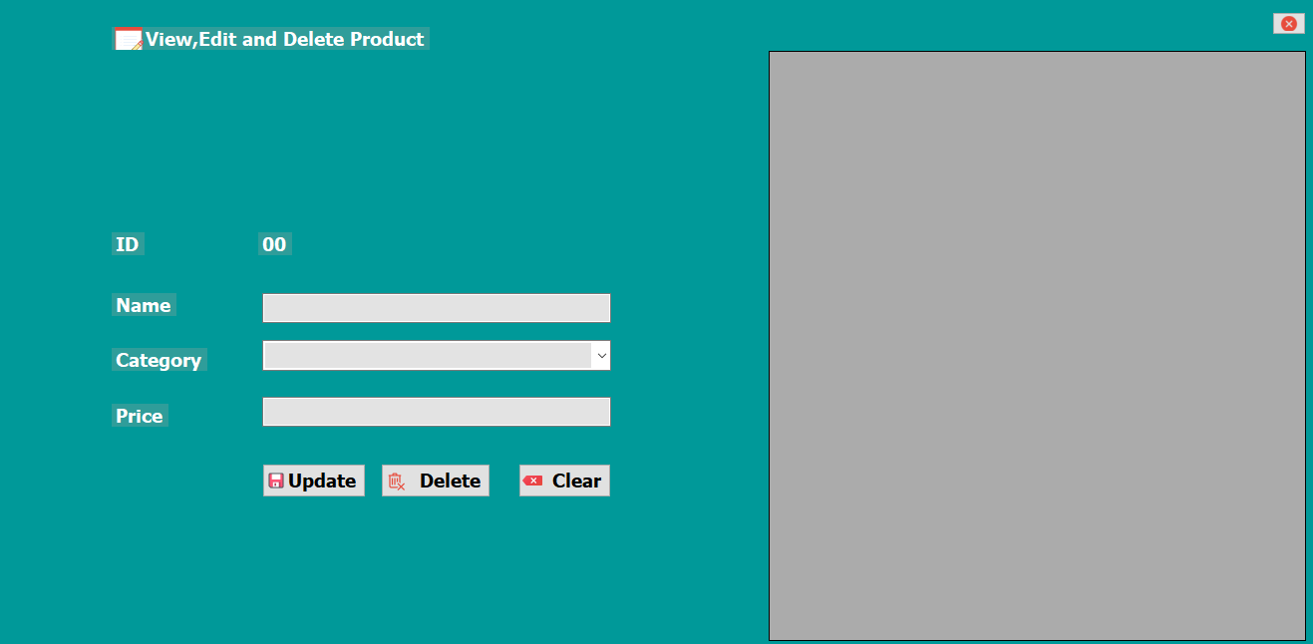
Manipulate product
View , Edit &Delete Product
New Product

